Slide 1

Stability analysis of a smart power grid
Ironhack Data Analysis Bootcamp: Mid-term Project
Ajay Krishna & Danilo Giarlini

Slide 2

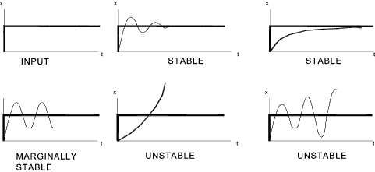




Stability in a smart grid
A system is said to be stable, if its output is under control.
Every user can both produce and consume energy, as long as the network is stable!

Slide 3
Input variables that define a house
Time constant/delay
(in secs): tau
Price Elasticity
(in kilo watts per Hertz): g
Power
consumed/generated
(in kilo watts): p

Slide 4

Data
Output variable
Input variables
Objective of the analysis
Predict how the stability (output variable) is affected by the input variables

Slide 5
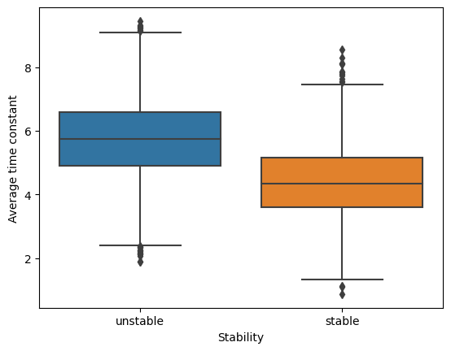
Time affects the stability

Slide 6
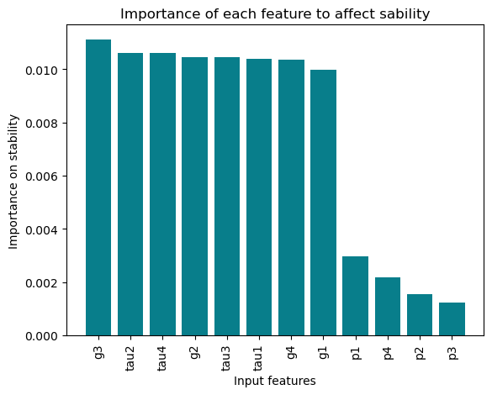
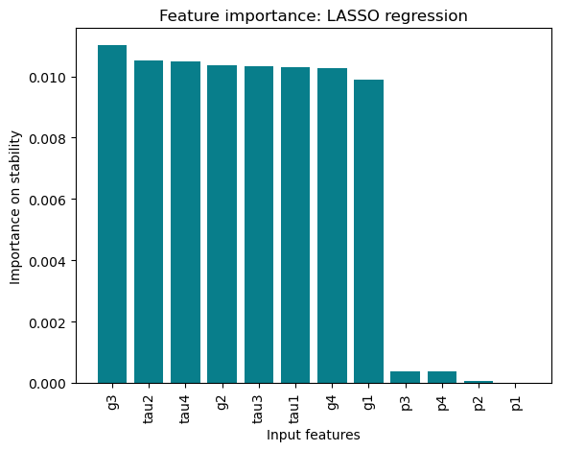
Importance of features for stability

Slide 7
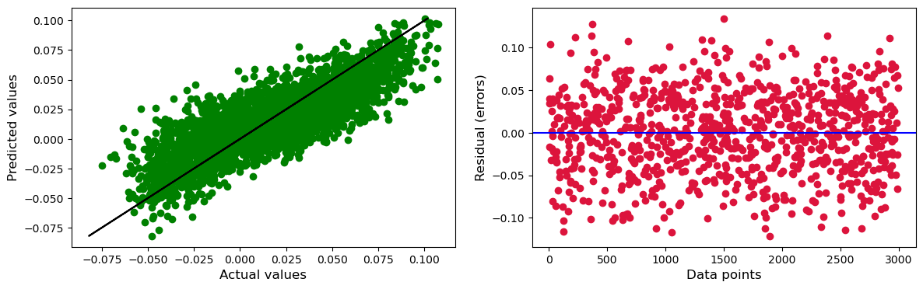
Predicted vs. actual

Slide 8

Outcomes
Insights into network stability
A statistical regression-based model of a smart grid
Predicted the stability of the network
Cross validation of prediction and actual values

Slide 9

Usability & extensions
A general stability indicator tool in the design process
The model can be extended for a larger network
For a new user/house to be connected to an existing network: the tool predicts whether the chosen parameters yield stability

Slide 10

Thank you!

